Slide 1
Orientation Analysis Plugin
Grant Harris,
Dec. 2013

Slide 2
Circular/Directional Statistics
Regular NxN grid
  Re-scales grid interval size when zooming
Calculates Circular/Directional Statistics
for each area:
  Anisotropy, average
  Intensity Average (for FluorPol & Diatten)
  Orientation, average
  Orientation Standard Deviation
Overlays Indicators of Orientation
  Variable Indicator Attributes
    color
    transparency
    length
    width

Slide 3
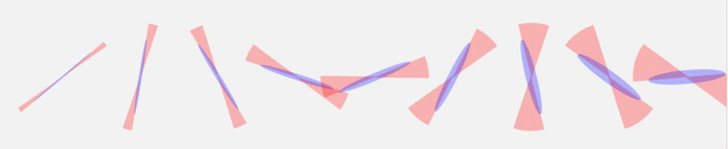
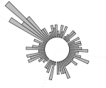
Visualization – Orientation Indicators
Regular Grid
  x & y intervals in pixels
Indicators
  Lines
    width, length
    color,transparency
  Ellipse
  Fan
  Circular histogram

Slide 4
Visualization – Orientation Indicators
Circular/Directional Statistics
Regular Grid
  x & y intervals in pixels
Indicators
  Lines
    width, length
    color,transparency
  Ellipse
  Fan
  Circular histogram

Slide 5
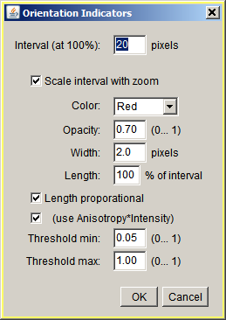
Input Dialog
The interval or grid size for averaging.
Indicators are displayed at the center of each of the areas in the grid.
If Scale interval with zoom is selected, the grid size is reduced as the magnification is increased until the interval is 1x1.
Select Color and opacity, and width of indicators.
Set the maximum lenth of indicators.
The length can be proportional to the value of anisotropy or (anisotropy x intensity).
Indicators will be only be shown where the value is within the threshold settings.

Slide 6
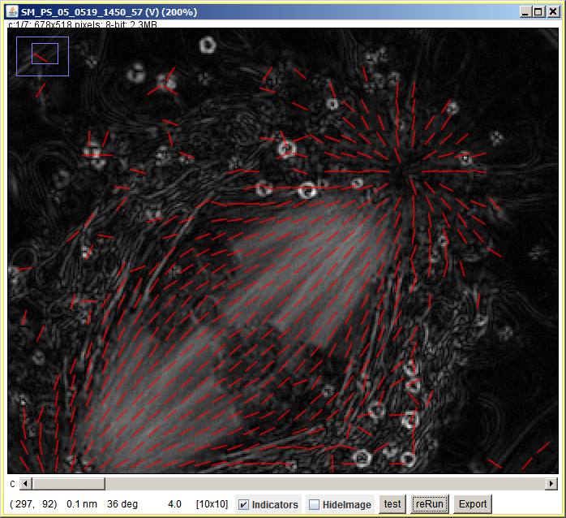
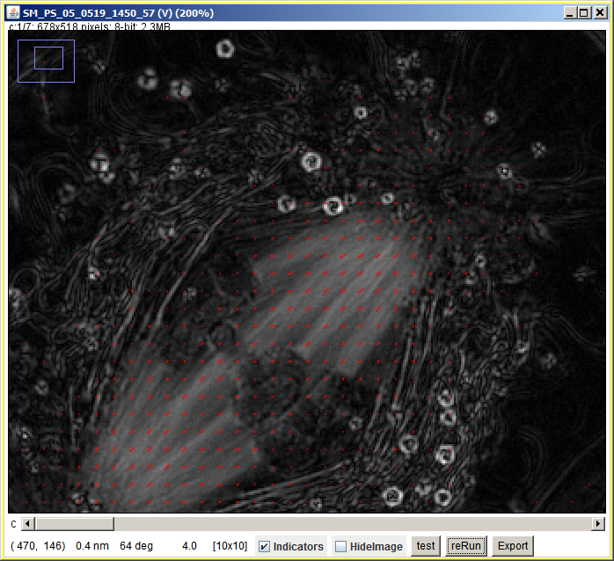
Indicator Length
Length Not Proportional
Length Proportional

Slide 7
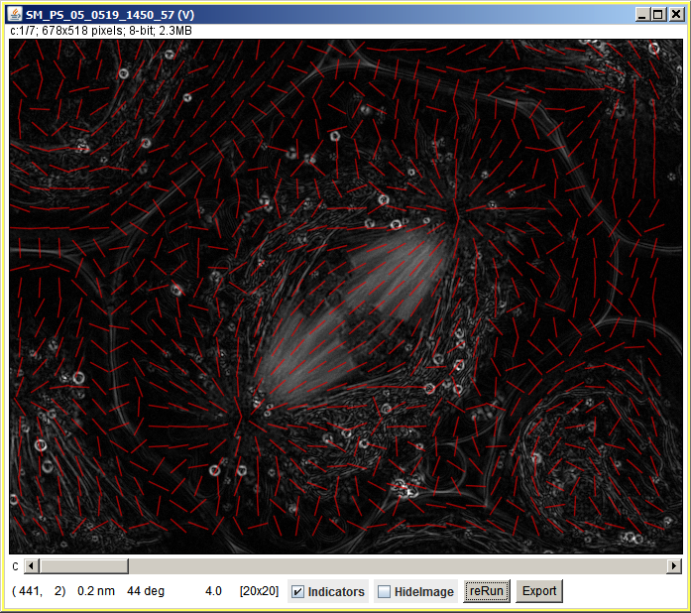
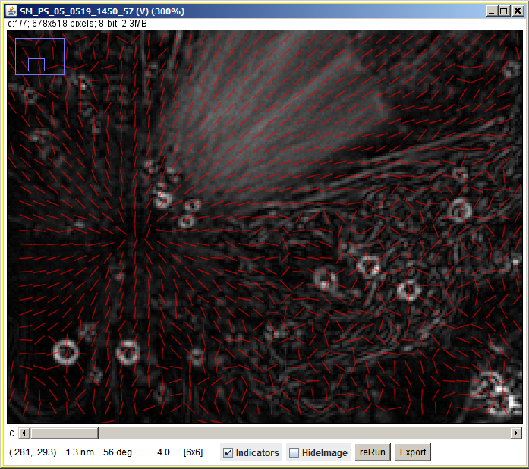
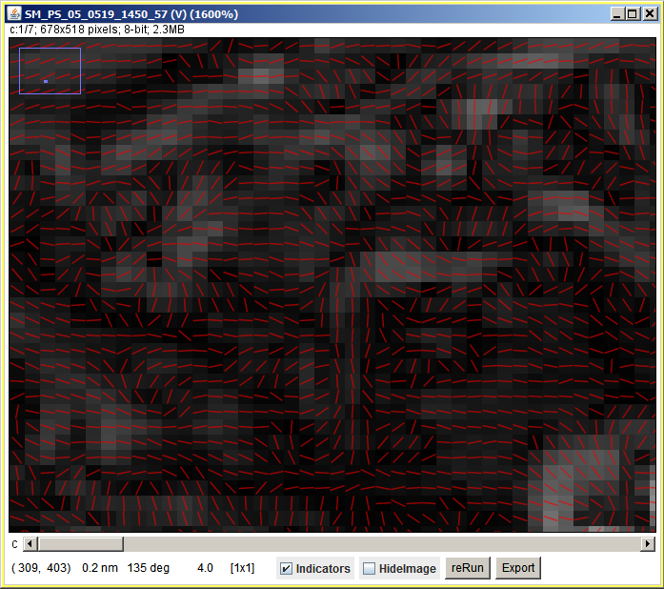
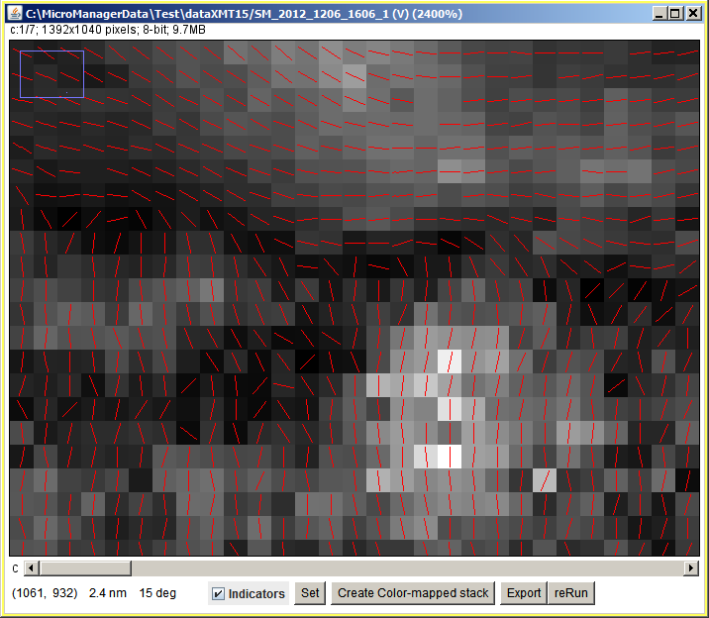
Grid Interval Scaled with Zoom
100%
20x20 grid
300%
6x6 grid
1600%
1x1 grid
2400%
1x1 grid

Slide 8
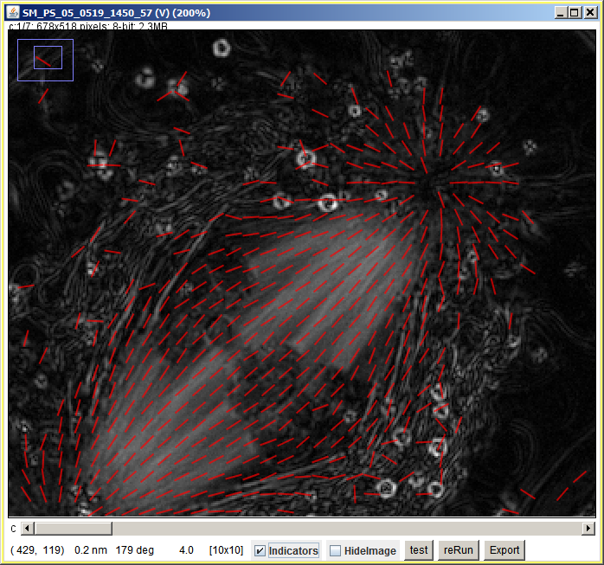
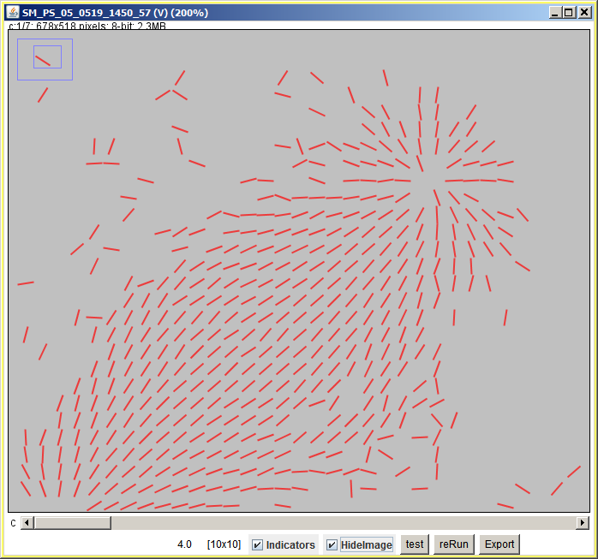
Hide Image
The underlying image can be hiden to
view the pattern of the orientation.

Slide 9
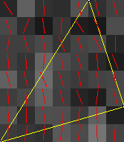
Export
Uses rectangular bounds of non-rectangular Roi
Export Image with Indicator Overlay
  Option to export series.
Data export
  to CSV format
  center point (if grid is 1x1, rounded to pixel)
  Anisotropy (or retardance)
  Orientation (radians)
  Intensity (0 if not used)

Slide 10
Visualizing/Measuring Change of Orientation
Within dataset
Between datasets

Slide 11
Measurements on ROIs
Compute circular statistics for pixels within an arbitrary Roi.
Add to ImageJ’s Measurement function
Integrate with RoiManager

Slide 12
To Do…
Compare results from Orientation_Indicators and Hanna’s plugin…

Slide 13
Visualization – Color Mapping
Orientation Color Mapping
  Color spaces
    HUSL - iso-luminent

